Slide 1


Quick Start
※ In this document, “Exastro IT Automation” is described as “ITA".
Version 1.2
Exastro developer

Slide 2
Table of Contents
Introduction
1.1 Web Console Login Screen
1.2 Screen Description: Main menu
1.3 Screen Description: Other Menus
Procedure Description
2.1 Overall Procedure and Work Scope
Preparation
3.1 Registering an IaC
3.2 Creating the Workflow Including the IaC
3.3 Registering a Target Linux Machine in Device list
Execution
4.1 Registering a New Operation Name
4.2 Connecting the Target to the IaC
4.3 Executing the Workflow
A Appendix
Reference 1 Ansible-Legacy: Single Execution
Reference 2 Ansible-Legacy: Checking the Operation Results
Reference 3 Sample Collection of Playbook

Slide 3
1. Introduction

Slide 4
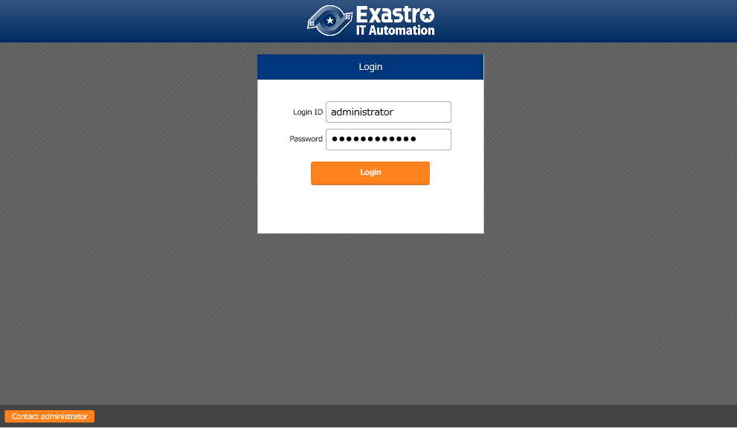
1.1 Web Console Login Screen
Web console Login Screen
Access the following URL to display the Login screen: https://exastro-it-automation/
Immediately after the first login, you will be prompted to change your password.
To deploy IT Automation, refer to “ITA-online-install_en.pdf".

Slide 5
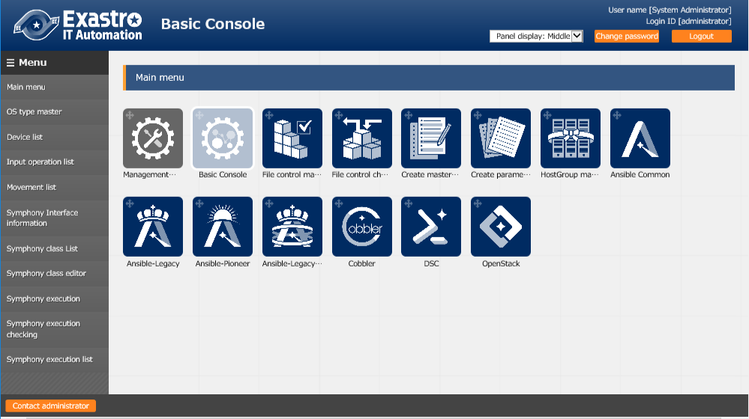
1.2 Screen Description: Main menu
Screen description: Main menu
Basic names are as follows:
Menu group
Refer to the manual
for the details of each function.
Menu

Slide 6
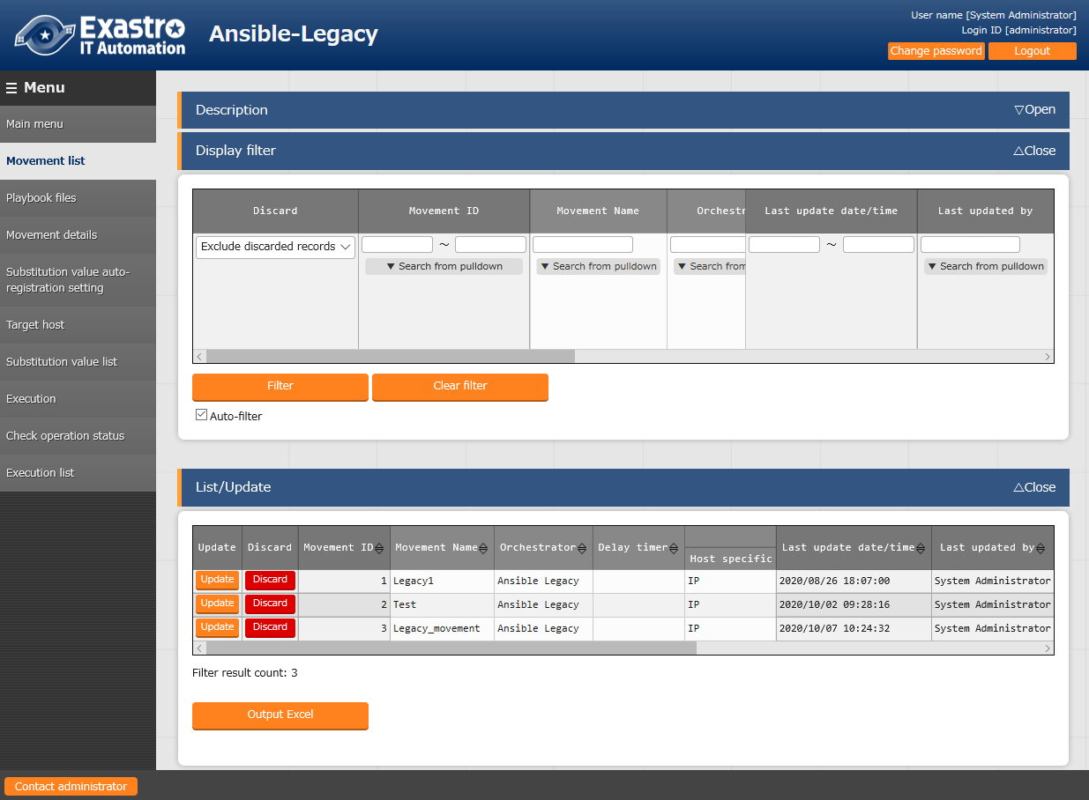
1.3 Screen Description: Other Menus (1/2)
Screen description: other menus
Basic names are as follow:
Sub menu
Submenu outline
Description : Describes the menu being displayed.
Display filter : Allows you to search for
registered information.
List/Update : Displays the registered information.
Refer to the manual
for the details of each function.

Slide 7
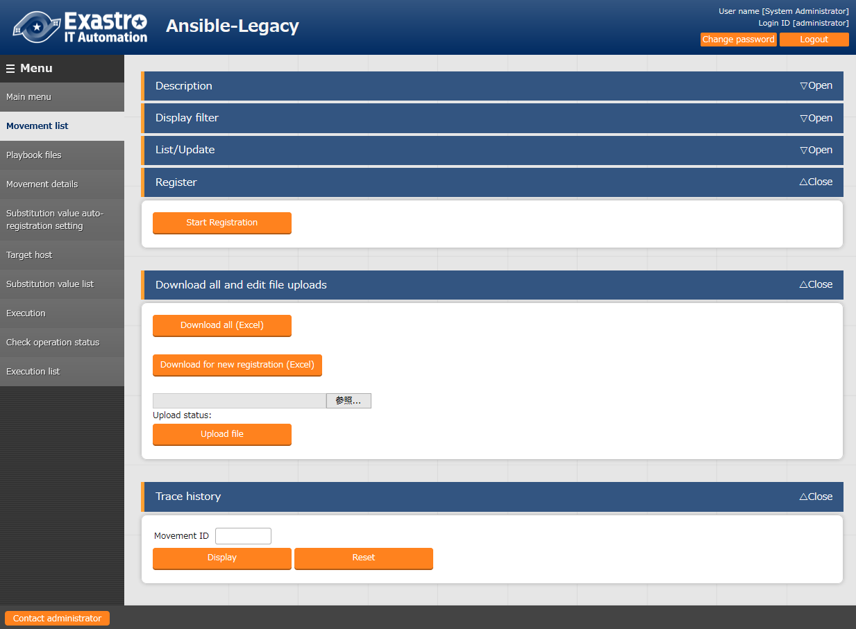
1.3 Screen Description: Other Menus (2/2)
Screen description: other menus
Basic names are as follows:
Sub menu
Submenu outline
Register : Allows users to register records from the Web.
Download all and edit file uploads
: Allows for IN/OUT processing with Excel.
Trace history : Allows users to display the track changes of registered records.
Refer to the manual
for the details of each function.

Slide 8
2. Procedure Description

Slide 9
2.1 Overall Procedure and Work Scope
Post-deployment procedure including executing Ansible-Legacy
The following illustrates the overall procedure and work scope for developers/operators:
Preparation
Registering an IaC (Movement)
Creating the Workflow (Conductor) Including the IaC
Registering a Target Linux Machine in Device list
Execution
Registering a New Operation Name
Repeat
Connecting the Target to the IaC
Executing the Workflow
The preparation contains IaC registration and workflow creation.
The execution includes repeatedly performing the registered workflow.

Slide 10
3. Preparation

Slide 11
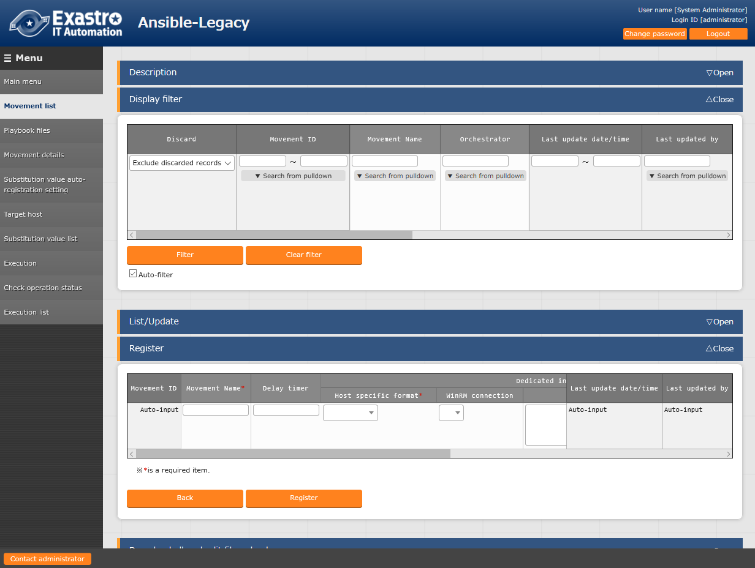
3.1 Registering an IaC (1/3)
Registering a new Movement in Movement list
From the Main menu screen, select Ansible-Legacy > Movement list. To start the registration, click the Register button. *Movement: A name of minimum work
Registering an IaC
Creating the Workflow Including the IaC
Registering a Target Linux Machine in Device list
Registering a New Operation Name
Connecting the Target to the IaC
Executing the Workflow
1
The following are mandatory fields:
- Movement Name
- Host specific format
2

Slide 12
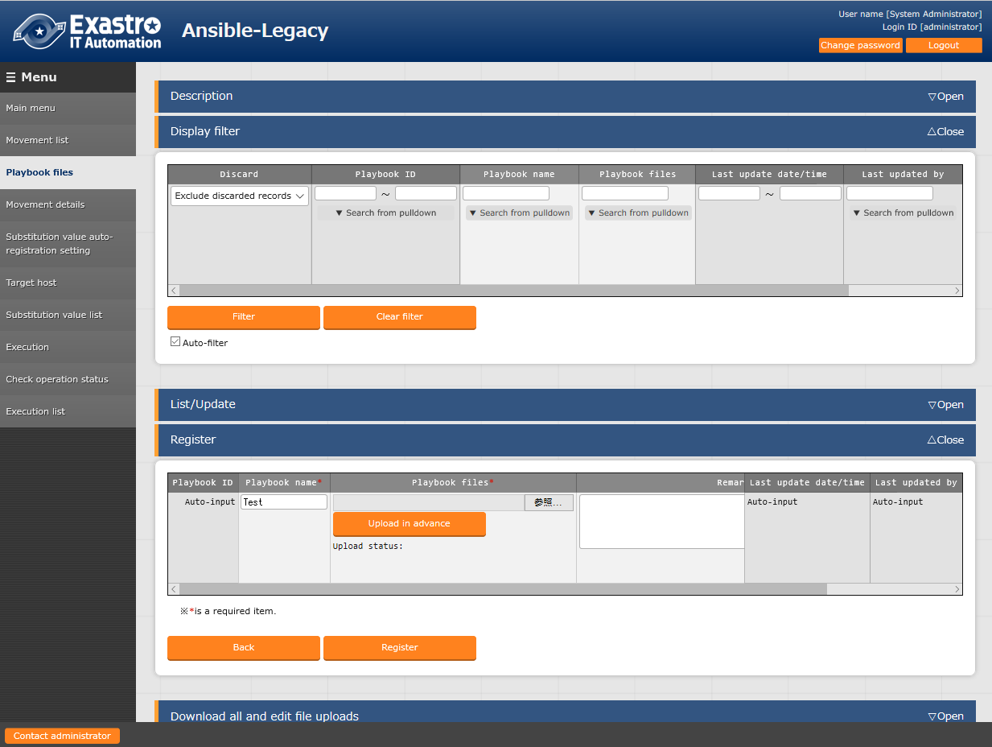
3.2 Registering an IaC (2/3)
Registering a new playbook in Playbook files
From the Main menu screen, select Ansible-Legacy > Playbook files. To start the registration, click the Register button. *If no playbook is prepared, use any of the playbooks described in Appendix (Reference 3).
Registering an IaC
Creating the Workflow Including the IaC
Registering a Target Linux Machine in Device list
Registering a New Operation Name
Connecting the Target to the IaC
*When uploading a playbook, specify the file and then make sure to click the Upload in advance button.
Executing the Workflow
1
2
The following are mandatory fields:
- Playbook name
- Playbook files

Slide 13
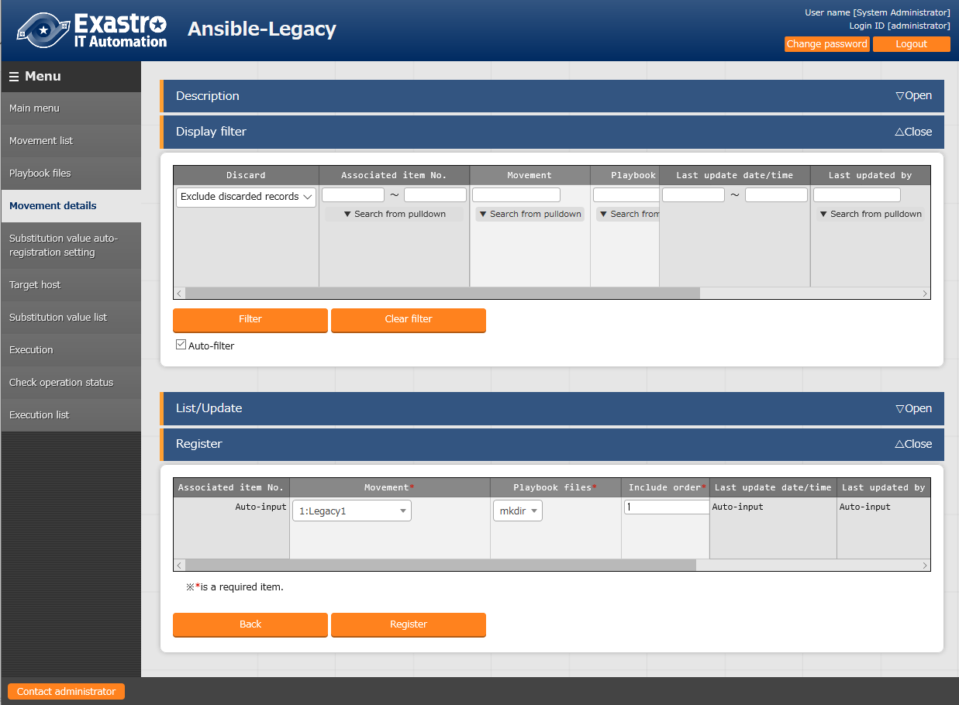
3.3 Registering an IaC (3/3)
Registering in Movement details
From the Main menu screen, select Ansible-Legacy > Movement details. To start the registration, click the Register button.
Registering an IaC
Creating the Workflow Including the IaC
Registering a Target Linux Machine in Device list
Registering a New Operation Name
In the Include order field, specify the order in which multiple playbooks are registered for each Movement. For 1:1, enter 1.
Connecting the Target to the IaC
Executing the Workflow
1
The following are mandatory fields:
- Movement
- Playbook files
- Include order
2

Slide 14
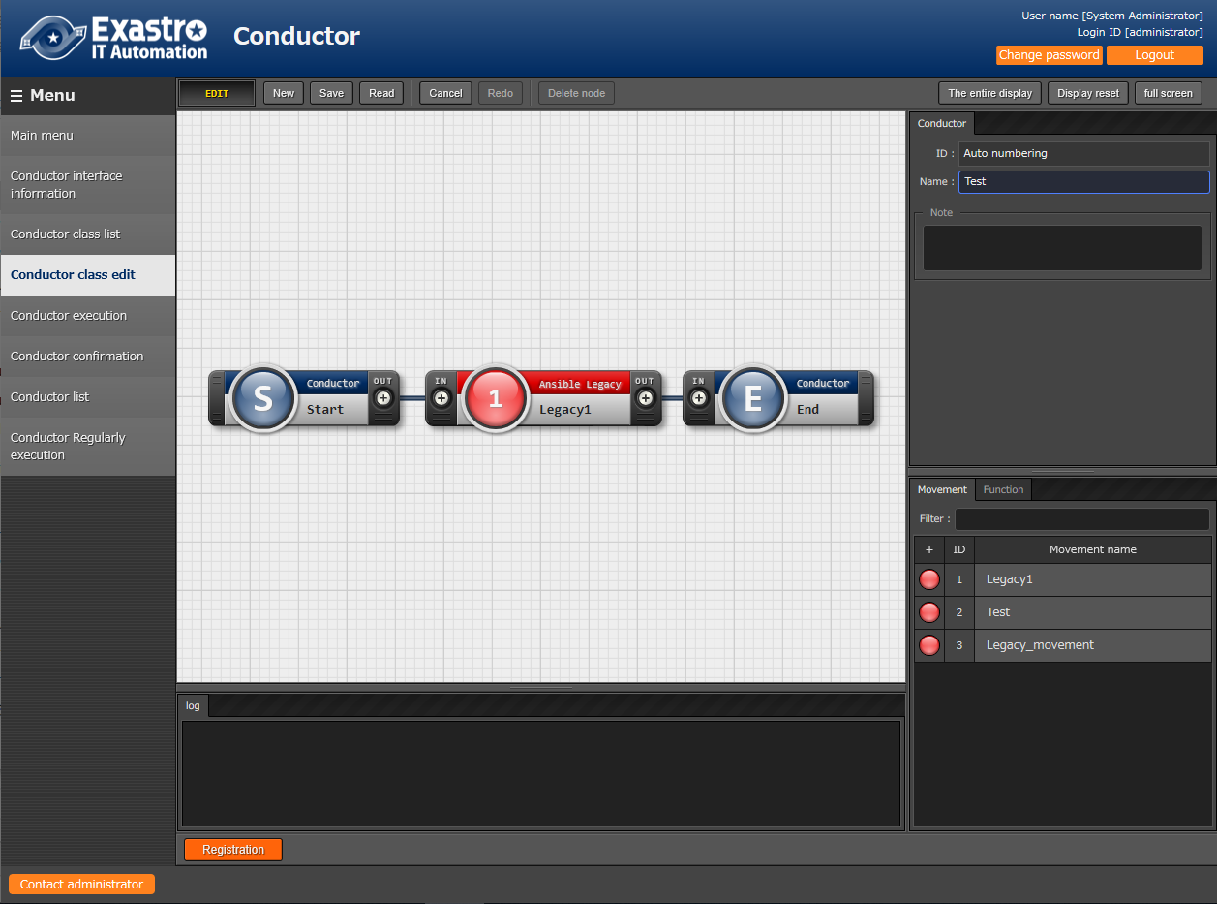
3.4 Creating the Workflow Including the IaC
Creating a workflow in Conductor class editor
From the Main menu screen, select Conductor> Conductor class editor.
Register
a Conductor name.
Registering an IaC
1
Creating the Workflow Including the IaC
Text such as a work description can be entered.
Registering a Target Linux Machine in Device list
Registering a New Operation Name
2
Connecting the Target to the IaC
3
Drag and drop
Connect by dragging “OUT” to “IN”
Executing the Workflow
From the list of created Movements, drag and drop the desired Movement to register it.
4

Slide 15
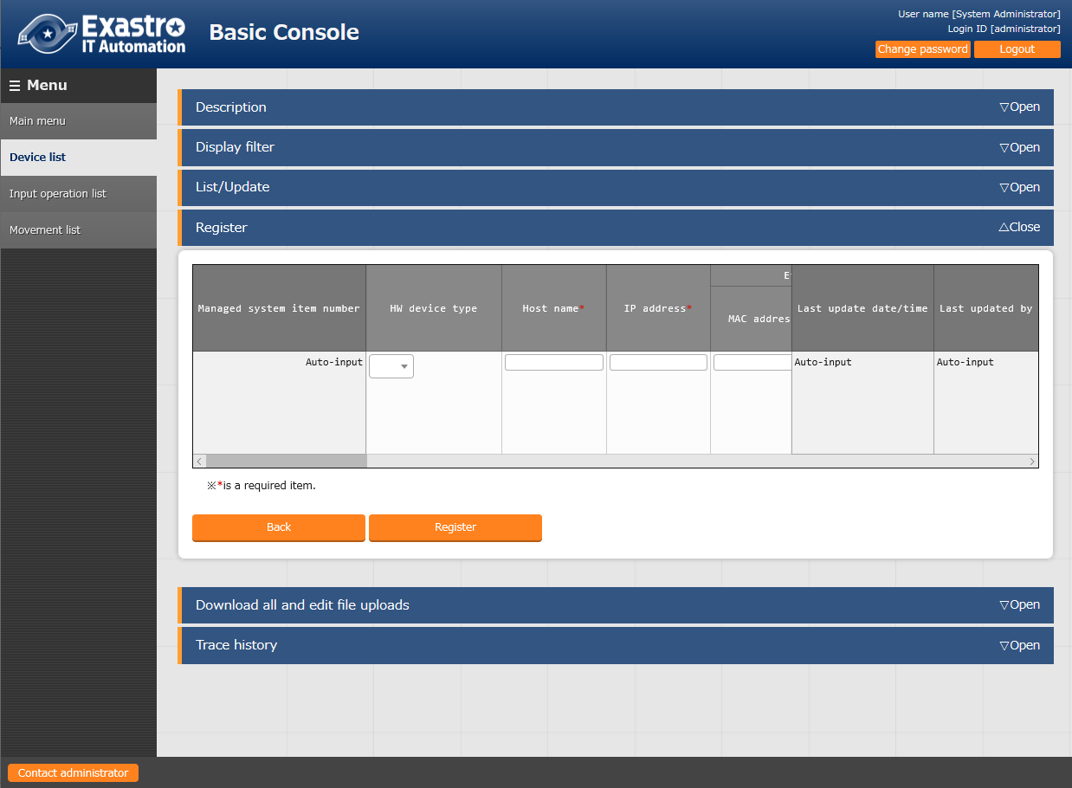
3.5 Registering a Target Linux Machine in Device list
Registering a new target host in Device list
From the Main menu screen, select Basic Console > Device list. To start the registration, click the Start Registration button.
Registering an IaC
Creating the Workflow Including the IaC
1
Registering a Target Linux Machine in Device list
Registering a New Operation Name
Connecting the Target to the IaC
Executing the Workflow
2
For executing Ansible-Legacy, the following are mandatory fields: - Host name - IP address - Login user ID - Login password management - Login password - Authentication method*
*This document describes it as password authentication.

Slide 16
4. Execution

Slide 17
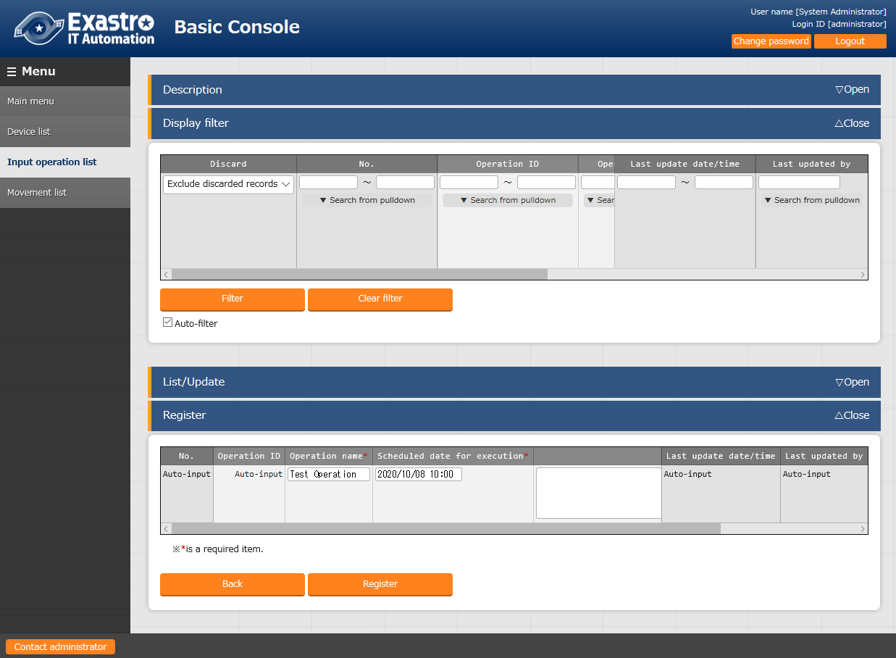
4.1 Registering a New Operation Name
Registering a new operation name on Input operation list
From the Main menu screen, select Basic Console > Input operation list. To start the registration, click the Start Registration button. *Operation refers to the operation name used in the IT Automation system that indicates the whole operation.
Registering an IaC
Creating the Workflow Including the IaC
Registering a Target Linux Machine in Device list
Registering a New Operation Name
Connecting the Target to the IaC
Executing the Workflow
1
The following are mandatory fields:
- Operation name
- Scheduled date for execution
2

Slide 18
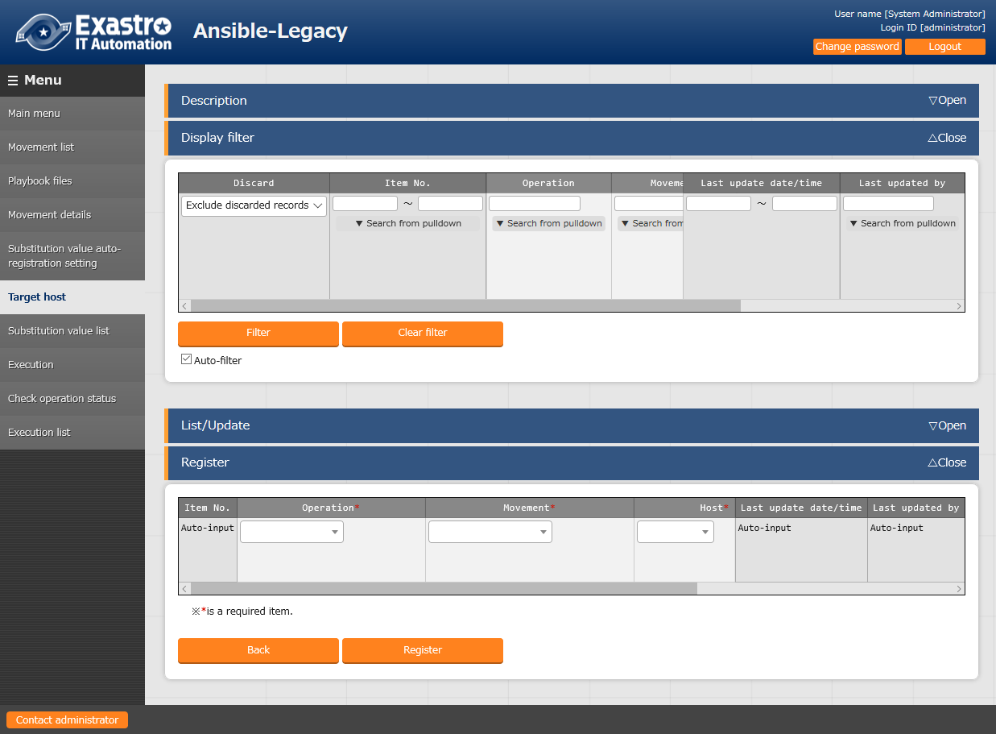
4.2 Connecting the Target to the IaC
Registering on Target host
From the Main menu screen, select Ansible-Legacy > Target host. To start the registration, click the Start Registration button.
Registering an IaC
Creating the Workflow Including the IaC
Registering a Target Linux Machine in Device list
Registering a New Operation Name
From the Host list, select the desired target device.
Connecting the Target to the IaC
Executing the Workflow
1
The following are mandatory fields:
- Operation
- Movement
- Host
2

Slide 19
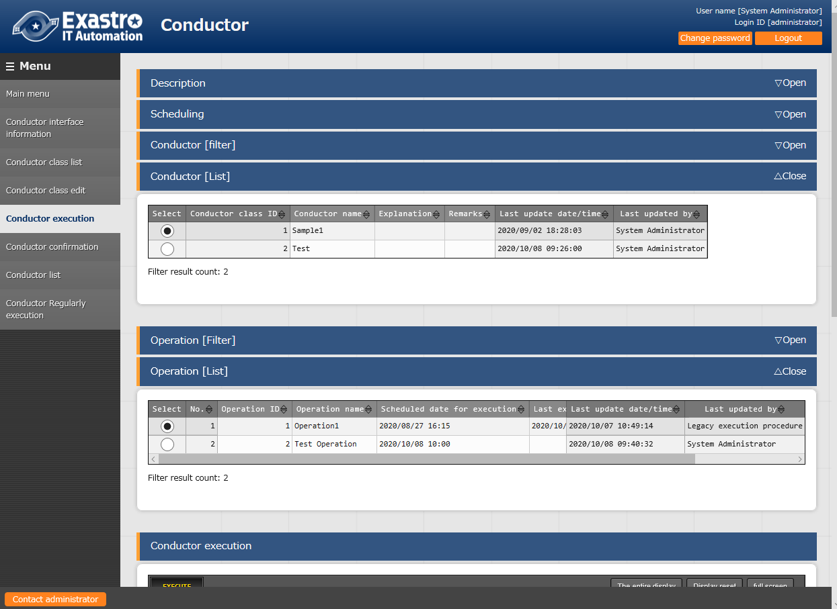
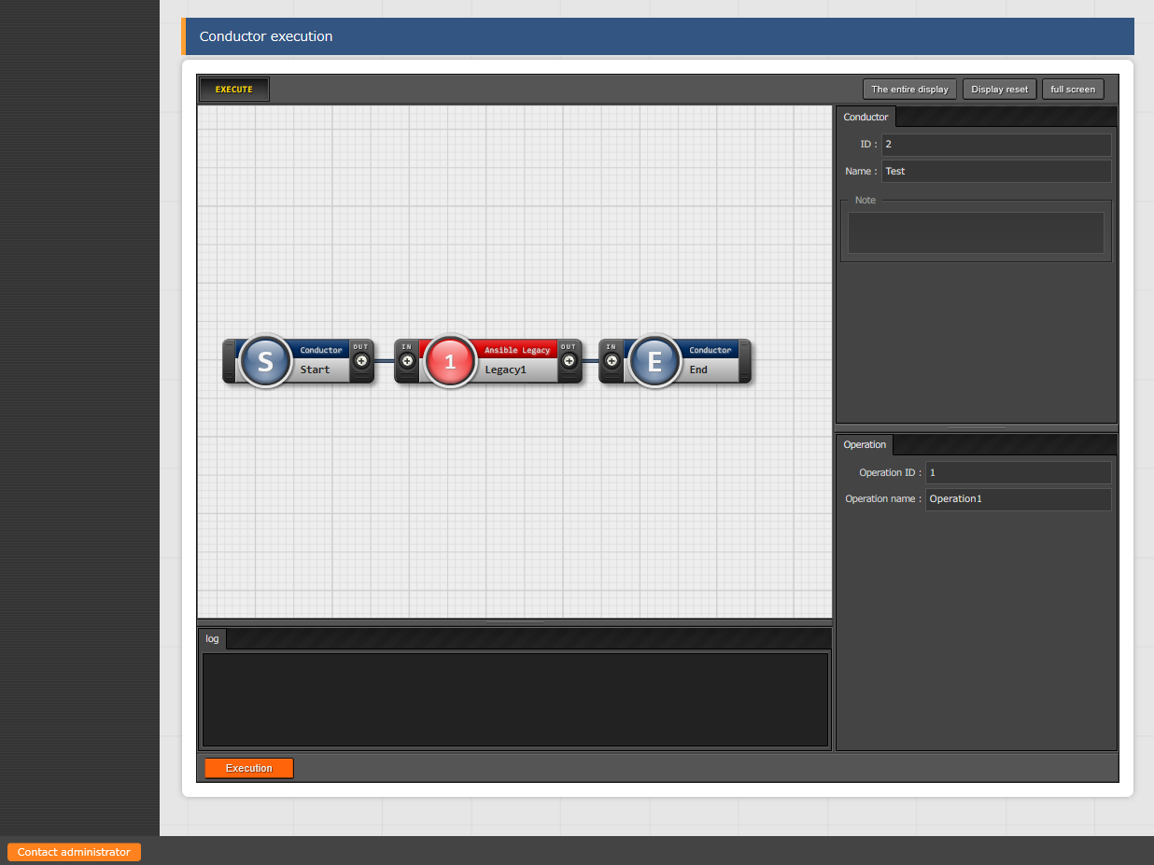
4.3 Executing the Workflow (1/3)
Executing Conductor
From the Main menu screen, select Conductor > Conductor execution.
Registering an IaC
1
Creating the Workflow Including the IaC
Registering a Target Linux Machine in Device list
Registering a New Operation Name
2
Connecting the Target to the IaC
Executing the Workflow
Choose the Operation and Conductor to be executed and press the “ Execution “ button.
3

Slide 20
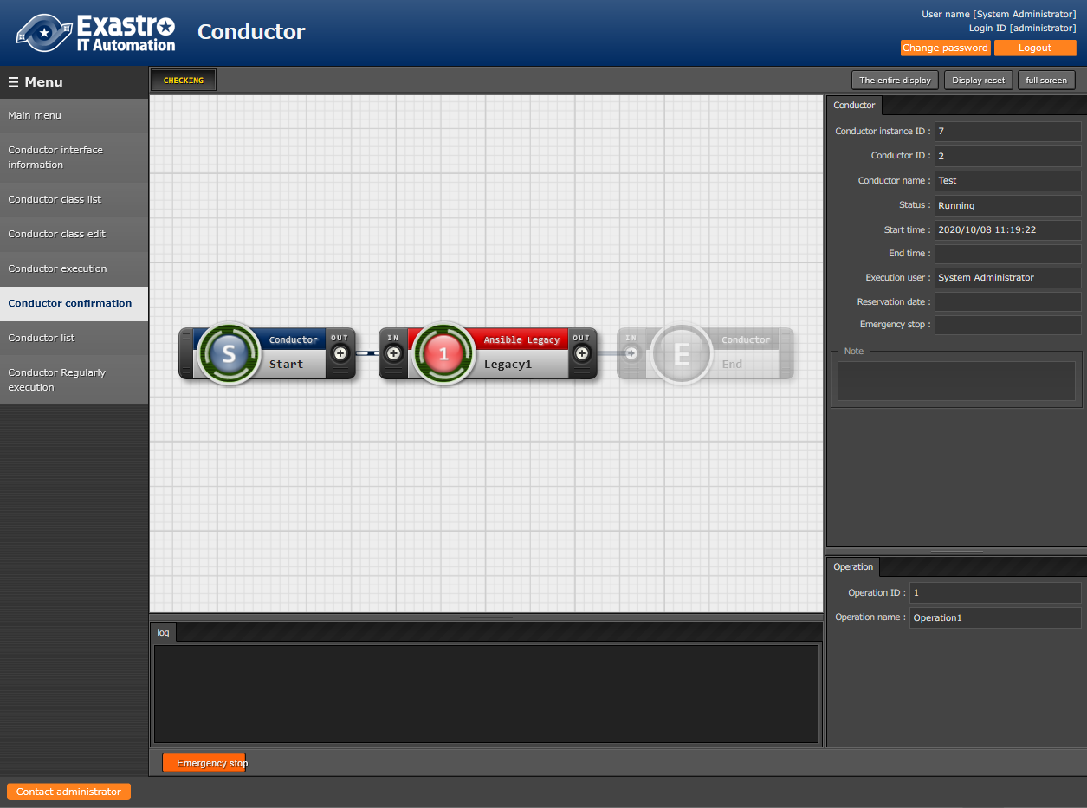
4.3 Executing the Workflow (2/3)
Checking the execution results
Executing will change the screen to the “Conductor Confirmation” menu screen and show the execution status and log.
Registering an IaC
Creating the Workflow Including the IaC
Registering a Target Linux Machine in Device list
Registering a New Operation Name
Connecting the Target to the IaC
Executing the Workflow
Choose the Operation and Conductor to be executed and press the “ Execution “ button.

Slide 21
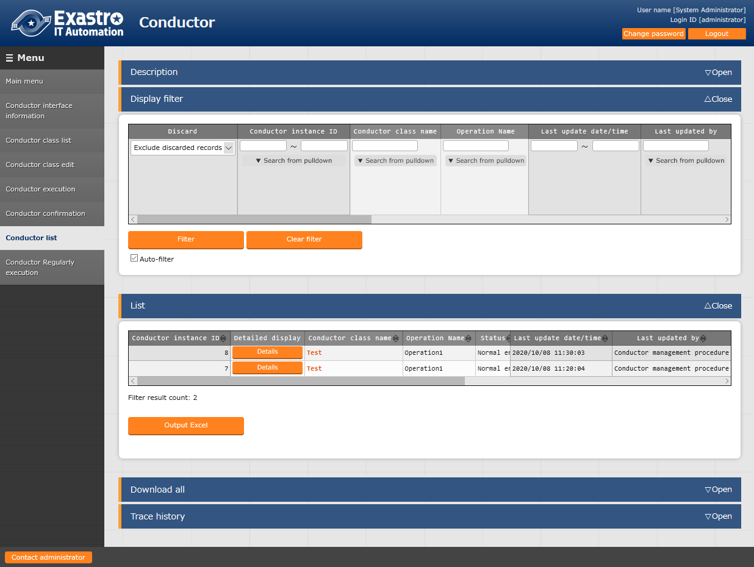
4.3 Executing the Workflow (3/3)
Checking the execution results in “Conductor execution list”
From the Main menu screen, select Conductor >Conductor list.
Registering an IaC
Creating the Workflow Including the IaC
Registering a Target Linux Machine in Device list
Registering a New Operation Name
Connecting the Target to the IaC
Executing the Workflow
Enter the narrowed down data in the Display filter lists and press the “ Details” button to open Detailed information in a new tab.

Slide 22
A Appendix

Slide 23
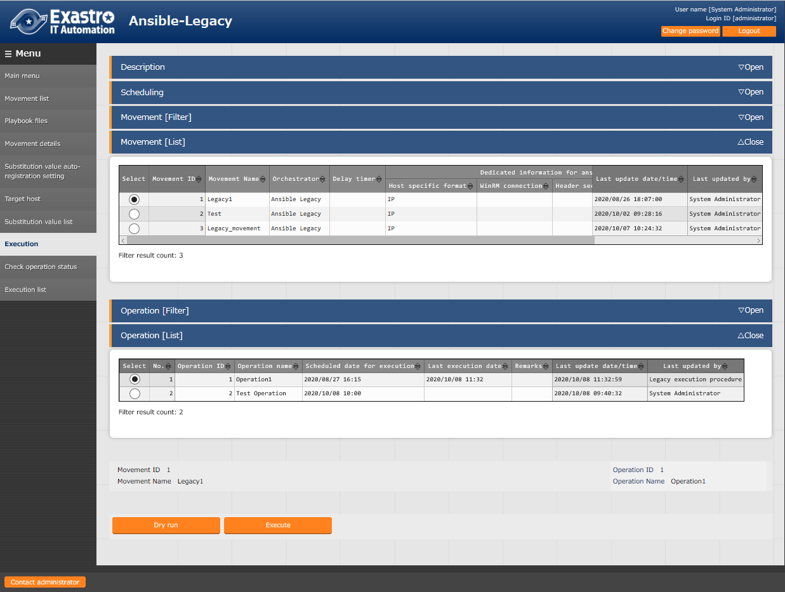
Reference 1 Ansible-Legacy: Single Execution
Execution
In Ansible-Legacy, the Execution menu offers the Execute and Dry run functions for each Movement.
1
Select the created Movement
2
Select the operation
connected to the Movement
3
Dry run:
Checks the playbook connection/syntax
Execute:
Executes the playbook

Slide 24
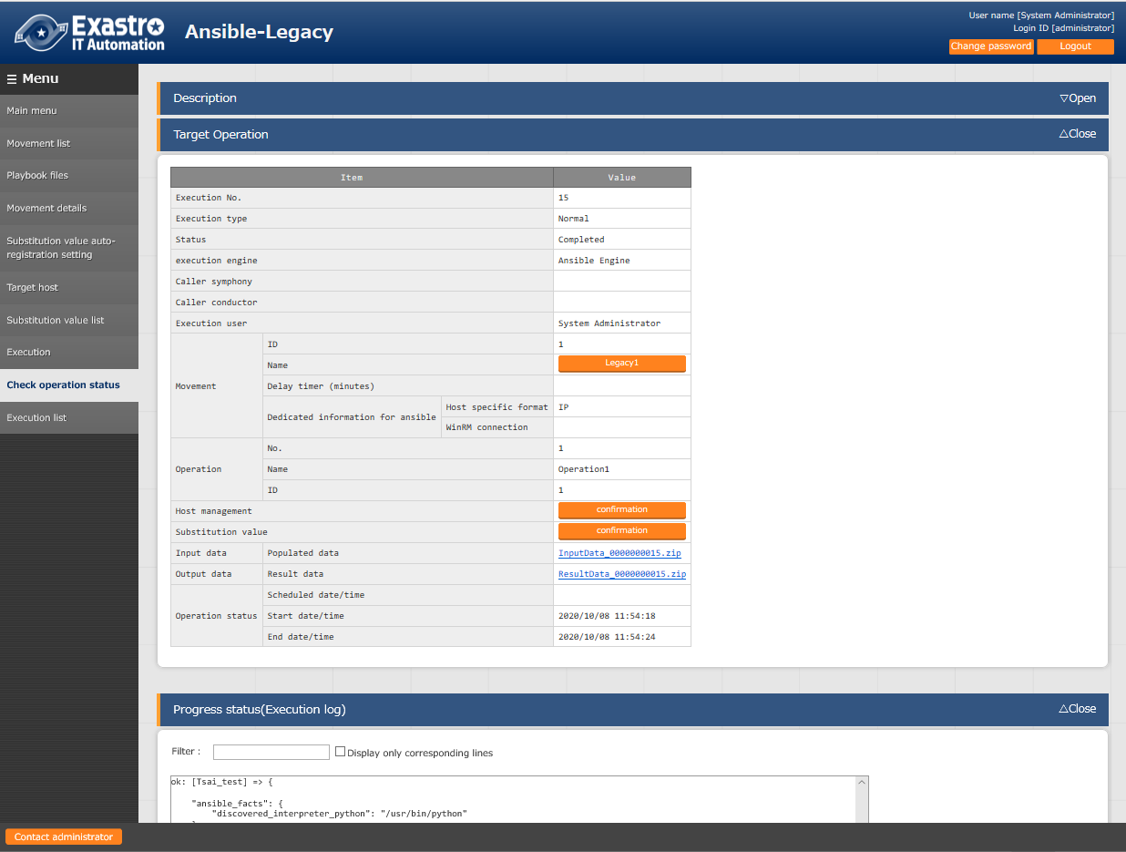
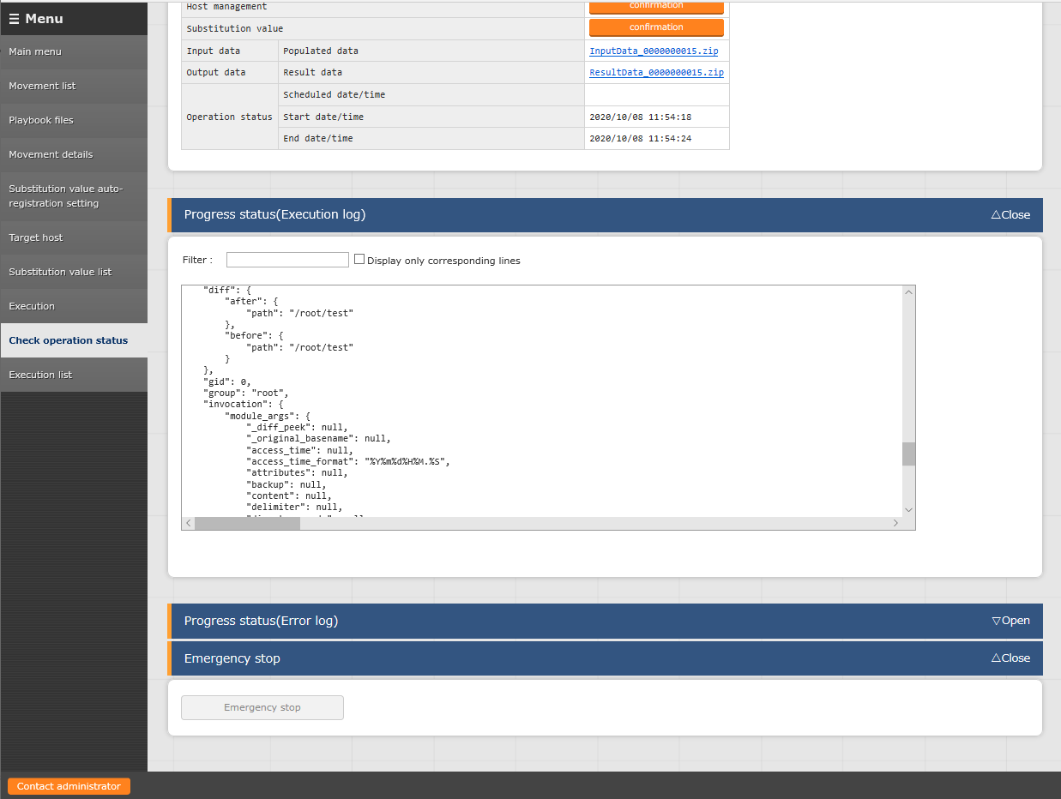
Reference 2 Ansible-Legacy: Checking the Operation Results
Checking the operation results
Performing the function (Execute or Dry run) displays the execution status and logs.
Execution status: Allows you to check the execution evidence and the input data.
point
point
Execution log and Error log:
Can be checked in real time.

Slide 25
Reference 3 Sample Collection of Playbook
Sample playbooks (for Linux servers)
The following playbooks are samples. They can be used as is, but you can freely change the parts in red. *The character code is "UTF-８", the line feed code is "LF", and the extension is "yml" format.
Keep the indents in mind.
- name: Make Work Directory demonstration
file: path: /tmp/demodirectory state: directory mode: 0755
A directory called ”demodirectory” is
created under the /tmp directory.
point
- name: Sample User add user: name: ITA createhome: no uid: 4401 group: users
point
An ITA user is created. Delete the user after checking the operation.
point
The following definition is reserved variables
prepared in advance that are used
when a file is brought back to the
IT Automation server.
{{ __workflowdir__ }}/{{ inventory_hostname }}
point
- name: Collect Files fetch: src=/etc/hosts dest={{ __workflowdir__ }}/{{ inventory_hostname }} flat=yes
/etc/hosts files are collected.
The collected files are gathered in the zip file of the result data.

